Slide 1
Heartrate Sensor
Baltej Bal

Slide 2


Proposal
Why Am I Working With A Heartrate Sensor or Smartwatch?
Wearable device or a smart watch that detects the pulse/heart rate
To make a smartwatch that alerts the user for any drastic changes in the users vital signs.
It allows us to keep track of health condition of the user
- Grandparents, Parents or yourself
Gives alerts or calls users emergency contact if drastic change in vital signs.

Slide 3
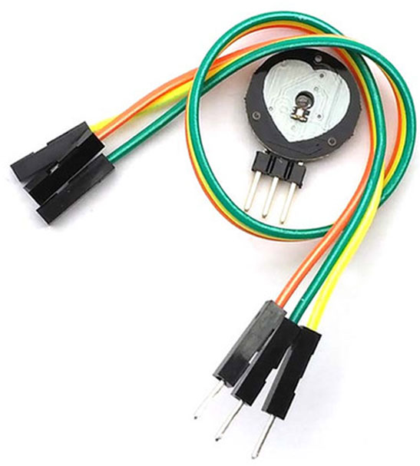
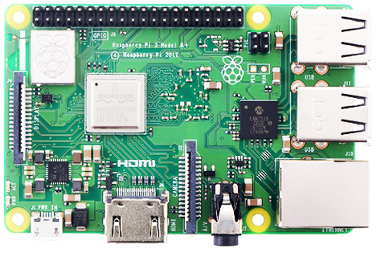
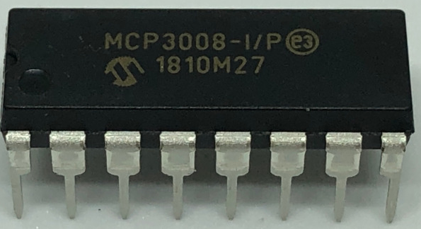
Budget
Raspberry Pi 3 B+ => 74.99 off AdaFruit
Pulse Sensor(SEN-11574) => 23.78 from Canada Robotics
MCP3008(ADC) => 13.95 off Amazon
In total this project cost me 112.75
Stuff I already owned
Acer Laptop
Electronic Parts Kit

Slide 4
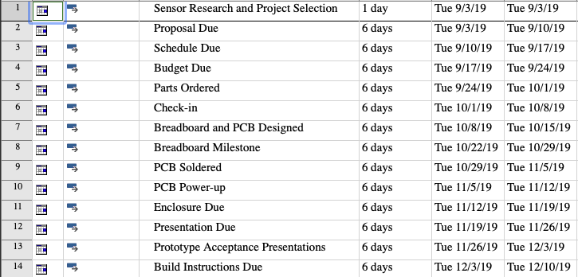
Schedule
The project was divided into milestones totaling up to 14 weeks with different tasks due each week.
Most milestones were completed during our weekly classes
This course required time commitment outside of class
This project can be completed over a weekend supposing that all items are owned before starting
My Est time commitment for this project was 16-18 hours

Slide 5
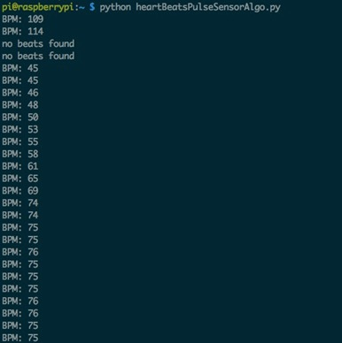
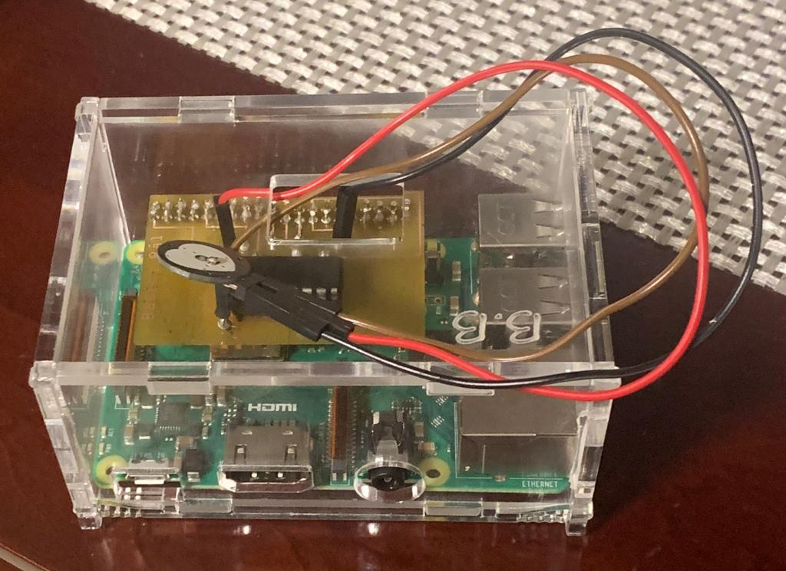
My Project
Final project within enclosure
Screenshot Of Working Sensor

Slide 6

Course knowledge utilized from previous courses
Tech150 – Electronic Circuits:
Designing and set up physical circuits using breadboards and wires
CENG252 – Embedded Systems:
Interfacing a sensor, set up a development platform, and we maintained a Git repository
Tech103 – Digital Fundamentals
Learned to use different ADC’s

Slide 7
THANK YOU

